Slide 1


DECODE SIH 2026
CITIZENOS
AI-Powered Multilingual Digital Citizen Assistant
PRESENTED BY:
Ctrl+Innovate

Slide 2

TEAM MEMBERS

Slide 3
PROBLEM STATEMENT
Fragmented Government Service Discovery & Application for Citizens in India
What does this Problem Aim to Solve?
India has over 2,000 government schemes spread across multiple ministries. The average citizen cannot identify which scheme they qualify for or where to apply. Despite 95.15% of villages having internet access, citizens face severe barriers including complex bureaucratic language and lack of guided application support. Existing portals list services but do not reason, recommend, or assist.
Why did your team choose this?
This problem directly affects over 1.4 billion Indians, with the greatest impact on rural populations, farmers, and those with limited digital literacy. Our team believes technology should eliminate barriers to government access. CitizenOS addresses this at the intersection of AI, multilingual NLP, and e-governance, aligning with India's Digital Public Infrastructure vision.

Slide 4

REAL-WORLD PROBLEM ALIGNMENT
WHO FACES THIS ISSUE?
CURRENT GAP IN SYSTEM
Rural citizens (425M rural smartphone users)
Portals are filter-based & keyword-driven
Farmers seeking subsidies (PM-KISAN, PMFBY)
No AI layer to verify eligibility
No document intelligence for uploads
Senior citizens and pension beneficiaries
No voice interface for non-readers
Women heads of households
India's EGDI ranking: 97 of 193 UN states
Citizens with limited digital literacy
PRACTICAL SOLUTION FIT
CONNECTION TO SCHEMES
CitizenOS acts as an intelligent government navigator. A citizen speaks naturally in their language — the AI detects eligibility, prepares documents, explains processes in simple terms, finds the nearest application centre, and tracks progress.
Digital India
IndiaAI Mission
BHASHINI (Language Translation)
DigiLocker
PM-KISAN

Slide 5

PROPOSED SOLUTION
WHAT ARE YOU BUILDING?
3-4 KEY FEATURES
CitizenOS is an AI-powered multilingual digital citizen operating system — a personal government officer for every Indian citizen. Instead of citizens navigating dozens of fragmented government websites, the AI navigates the systems. The citizen only talks naturally. The AI detects language, verifies eligibility, extracts document data via OCR, explains processes in simple regional language, generates step-by-step application roadmaps, locates the nearest Common Service Centre, and tracks application progress. It works across voice, text, WhatsApp, and IVR channels.
Hybrid RAG + Government Knowledge Graph for accurate, hallucination-free scheme matching across 2,000+ schemes.
■
Interactive Eligibility Engine that interviews the citizen and scores every scheme with match percentages.
■
Document Intelligence using PaddleOCR to extract, validate, and flag issues in Aadhaar, PAN, and certificates.
■
Multilingual Voice Interface supporting 12+ Indian languages via BHASHINI APIs with offline capability.
■
WHAT MAKES IT INNOVATIVE?
No existing platform combines multilingual voice interaction, personalized eligibility scoring, OCR-based document intelligence, and scam detection into a single system. CitizenOS shifts from a passive information repository to an active, intelligent agent.

Slide 6
CORE AI MODULES
PART 1: INTELLIGENCE
GOVERNMENT KNOWLEDGE GRAPH
HYBRID RAG ENGINE
INTERACTIVE ELIGIBILITY ENGINE
Vector Search: Uses BGE-M3 embeddings for semantic similarity across 100+ languages.
■
Converts unstructured PDF schemes into structured graph objects.
Conducts a conversational interview with the citizen.
■
■
Captures 8+ parameters: Age, Income, Occupation, Category, Gender, Education, Disability, State.
Metadata Filtering: Filters by State, Department, and Category before retrieval.
■
■
Captures 15+ attributes: Name, Eligibility, Income Limit, Age, State, Documents, Benefits, Deadline, Department, FAQs, Application Process.
■
Knowledge Graph Integration: Combines structured data with unstructured text retrieval.
■
Evaluates the profile against all 2,000+ schemes in the Knowledge Graph.
■
Enables complex relational querying and inferencing.
■
Dramatically improves accuracy and eliminates the "hallucinations" common in standard LLMs.
Generates a personalized match score (e.g., PM-KISAN: 98%, PMFBY: 96%) for every applicable scheme.
Allows the AI to reason over data relationships rather than simply matching keywords in documents.

Slide 7
CORE AI MODULES
PART 2: INTELLIGENCE
DOCUMENT INTELLIGENCE
ELI10 & VOICE TRANSLATION
Uses advanced OCR (PaddleOCR) with 96.3% accuracy.
Translates complex bureaucratic language ("Applicants satisfying clause 7.3.2...") into simple terms.
■
■
Supports extraction across 80+ regional languages.
■
Delivers explanations in the user's native regional language.
Automatically parses Aadhaar, PAN, and Income Certificates.
■
■
Provides optional voice explanations via BHASHINI TTS for non-readers.
Detects missing documents, expired certificates, blurry scans, or wrong formats.
■
■
LIFE EVENT ENGINE
ROADMAP & SCAM DETECTOR
Creates a holistic "Family Wallet" profile (Father, Mother, Grandparents, Children).
Roadmap: Generates step-by-step execution plans (e.g., Visit nearest CSC -> Carry Aadhaar -> Fill application -> Submit).
■
■
Tracks major life events (e.g., marriage, birth, graduation).
■
Scam Detector: Verifies the authenticity of URLs provided by users to protect against phishing.
Proactively recommends necessary updates (Aadhaar, PAN, Bank KYC, Voter ID).
■
■
Complaint Assistant: Drafts and submits complaints to the correct government departments.
Identifies new schemes applicable to the entire household.
■
■

Slide 8
ADVANCED DELIVERY
CHANNELS
VOICE ASSISTANT
WHATSAPP & IVR ASSISTANTS
Full support for 12+ Indian languages.
Allows interaction without installing a dedicated app.
■
■
Powered by BHASHINI APIs for highly accurate ASR and TTS.
Crucial for non-smartphone users or those with limited storage.
■
■
Enables interaction for visually impaired or illiterate citizens.
Provides seamless, familiar communication channels.
■
■
OFFLINE MODE
NEARBY OFFICE FINDER
Caches essential scheme data locally on the device.
Locates Common Service Centres (CSCs) and Aadhaar Centers.
■
■
Supports offline eligibility checks and basic navigation.
■
Identifies local Tehsil offices and relevant departments.
Designed specifically for rural areas with poor connectivity.
■
■
Provides direct navigation and operating hours.
■
DIGILOCKER INTEGRATION
UNIVERSAL ACCESSIBILITY
Fetches and verifies documents automatically via API.
Combines all channels to ensure no citizen is left behind.
■
■
Drastically reduces the need for manual document uploads.
Bridges the digital divide between urban and rural India.
■
■
Ensures authenticity of submitted certificates.
Adapts to the user's specific technological constraints.
■
■

Slide 9
DEMONSTRATION:
THE FARMER'S JOURNEY
1
Voice Input: A farmer speaks in Hindi: "I am a farmer, what help can I get?"
AI Processing: The AI detects the language, identifies PM-KISAN and crop insurance eligibility.
2
Document Intelligence: The farmer uploads an Aadhaar card; the AI extracts details and detects a missing income certificate.
3
Guided Action: The AI explains the process in simple Hindi and locates the nearest Common Service Centre (CSC).
4
Comprehensive Support: The AI creates a checklist. Later, when the farmer has a billing issue, the AI drafts a complaint to the correct department.
5
This comprehensive journey showcases CitizenOS as an intelligent government navigator, combining multilingual conversation, document intelligence, and personalized execution.

Slide 10
WHY CITIZENOS
IS DIFFERENT
CAPABILITY
CITIZENOS PLATFORM
EXISTING SOLUTIONS
(MYSCHEME / UMANG / BHASHINI)
Core Approach
Passive information repositories and filter-based search.
Active AI navigator that executes the full citizen journey.
Eligibility Check
Users must manually read criteria and guess their fit.
Interactive scoring engine that interviews the citizen and matches against 2,000+ schemes.
Document Handling
Manual upload of PDFs; no validation of format or expiry.
PaddleOCR extracts data, validates formats, and flags missing documents.
Language & Accessibility
Primarily text-based, heavily reliant on English or standard Hindi.
12+ regional languages with full voice interaction (ASR/TTS) and offline mode.
Application Roadmap
Provides a simple "Apply Here" link to an external portal.
Generates step-by-step execution plans and locates the nearest CSC.
Security
No built-in protection against fake portals.
Integrated Scam Detector verifies URLs to protect against phishing.

Slide 11
TECH STACK &
ARCHITECTURE
Tech Stack
APIs/Libraries
Frontend
Backend
BHASHINI APIs (translation, speech recognition, synthesis)
■
Next.js, TypeScript, Tailwind CSS, shadcn/ui
FastAPI (Python)
PaddleOCR (document OCR - 96.3% accuracy, 80+ languages)
■
Database
Deployment
PostgreSQL + Qdrant (Vector DB)
Vercel, Railway/Render, Docker
BGE-M3 (multilingual embeddings, 100+ languages)
■
LangGraph + LangChain (agent orchestration and RAG pipeline)
■
Whisper (fallback speech-to-text)
■
DigiLocker API (document fetch and verification)
■
High-level Block Diagram
Citizen (Voice/Text)
→
Language Detection
→
Translation (BHASHINI)
→
Hybrid RAG Engine
→
Gov Knowledge Graph
→
Eligibility Engine
→
Application Planner
→
Response (Translated + Voice)

Slide 12
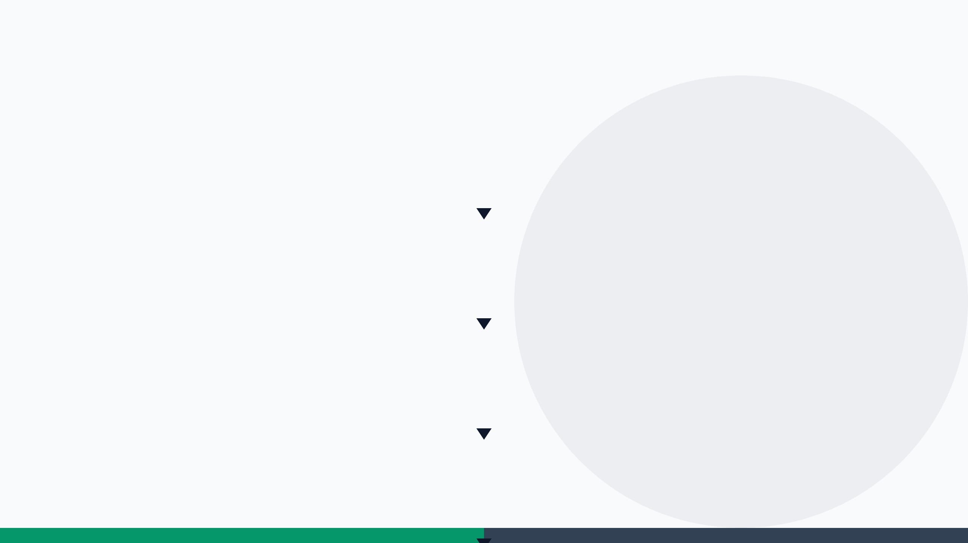
ARCHITECTURE DIAGRAM
LAYER 1 — USER INTERFACE
Web App (Next.js)
WhatsApp Bot
IVR Phone Line
Offline SMS Mode
LAYER 2 — AI GATEWAY
Voice Input
Whisper / BHASHINI ASR
Language Detection
BHASHINI Translation
LAYER 3 — INTELLIGENCE CORE
Hybrid RAG Engine
Qdrant Vector DB
Knowledge Graph
Eligibility Engine
PaddleOCR
LAYER 4 — OUTPUT & ACTION
Personalized Recommendations
Step-by-Step Roadmap
Scam Detection
Complaint Drafting
BHASHINI TTS
LAYER 5 — DATA LAYER & INFRASTRUCTURE
PostgreSQL
Qdrant
Govt Knowledge Graph
Vercel / Railway / Docker

Slide 13
THANK YOU
THANK YOU
CitizenOS — One AI. Every Government Service. Every Indian Citizen.

